Slide 1
Excel Advanced
Session 6

Slide 2
Contents
Filter with slicers
Pivot Tables
Pivot Charts
Slicers in Pivot Tables & Pivot Charts

Slide 3
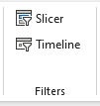
Filter with slicers

Slide 4
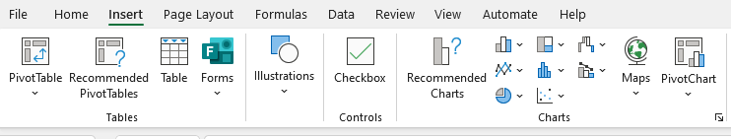
Pivot Tables & Pivot Charts

Slide 5
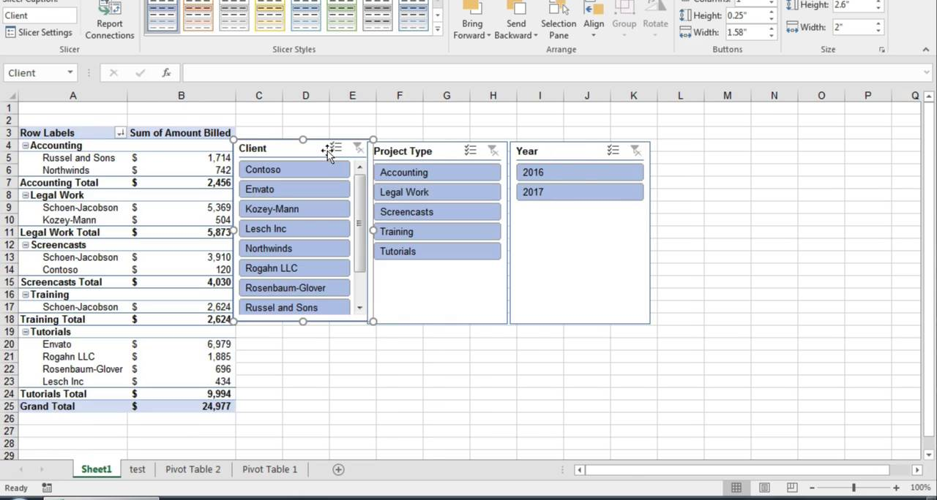
Slicers in Pivot Tables & Pivot Charts

Slide 6
Thank you
Brain Station
Eng. Dalia Morad
Excel Advanced S6

